Slide 1
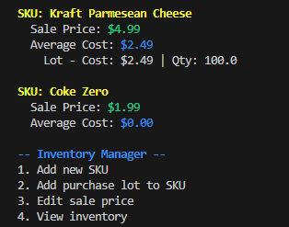
SimpleStock
Team: Avery Bellman
A Lightweight Inventory Manager
🧾Add SKUs and update pricing
💰 Track cost per lot and calculate average cost
💾 Save and load inventory from file

